Slide 1
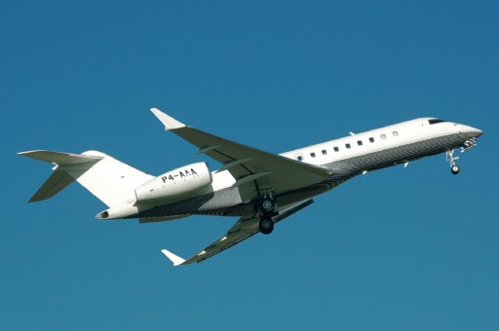
Aviation Management System
An Aviation Management System is a comprehensive platform designed to streamline and manage the operations of aviation-related activities, including flight scheduling, passenger services, crew management, aircraft maintenance, and airport operations. These systems play a critical role in ensuring safety, efficiency, and reliability in the aviation industry.
agement System is a comprehensive platform designed to streamline and manage the operations of aviation-related activities, including flight scheduling, passenger services, crew management, aircraft maintenance, and airport operations. These systems play a critical role in ensuring safety, efficiency, and reliability in
Group Members:
Nikhil Nigam(2300290140108)
Prashant Kumar(2300290140122)
Neha Sharma(2300290140106)

Slide 2
Project Abstract
Overview
Key Objectives
Approach
The Aviation Management System is an integrated solution that handles the operational, managerial, and logistical aspects of the aviation industry. It provides a structured approach to manage flights, passengers, crew, maintenance, and airport operations, ensuring a seamless experience for both service providers and customers.
..Enhance Operational Efficiency
. Improve Passenger Experience
. Ensure Safety and Compliance
. Optimize Resource Utilization
. Enable Data-Driven Decision-Making
.Requirement Analysis
.System Design
.Technology Selection
.Development
.Data Management

Slide 3

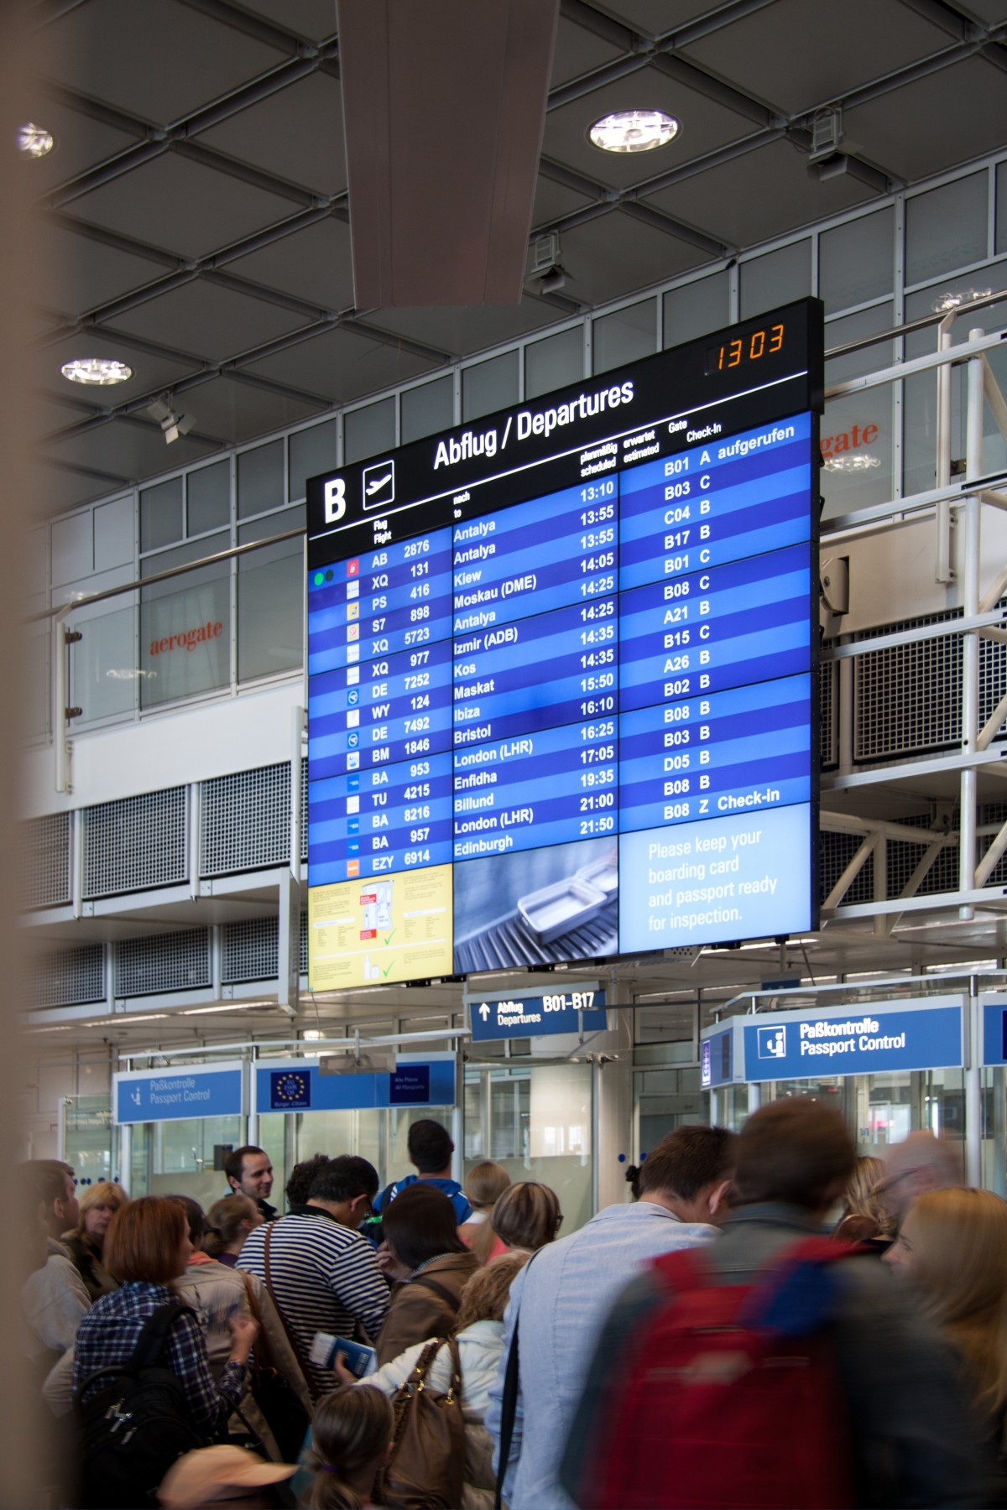
Project Goals and Objectives
Enhance Operational Efficiency
1
Develop a centralized system to manage flight scheduling, crew assignments, and airport operations.
2
System Design
.Modular Architecture: Design independent (e.g., flight
operations, maintenance, crew management) to enhance
scalability and.
.User Interface (UI) and User Experience (UX): Create an
intuitive interface for both end-users and administrators.
Ensure Safety and Regulatory Compliance
3
.Design a module to monitor and log aircraft maintenance
schedules and inspections.
Track crew certifications, training compliance, and duty hours to adhere to aviation safety standards.

Slide 4

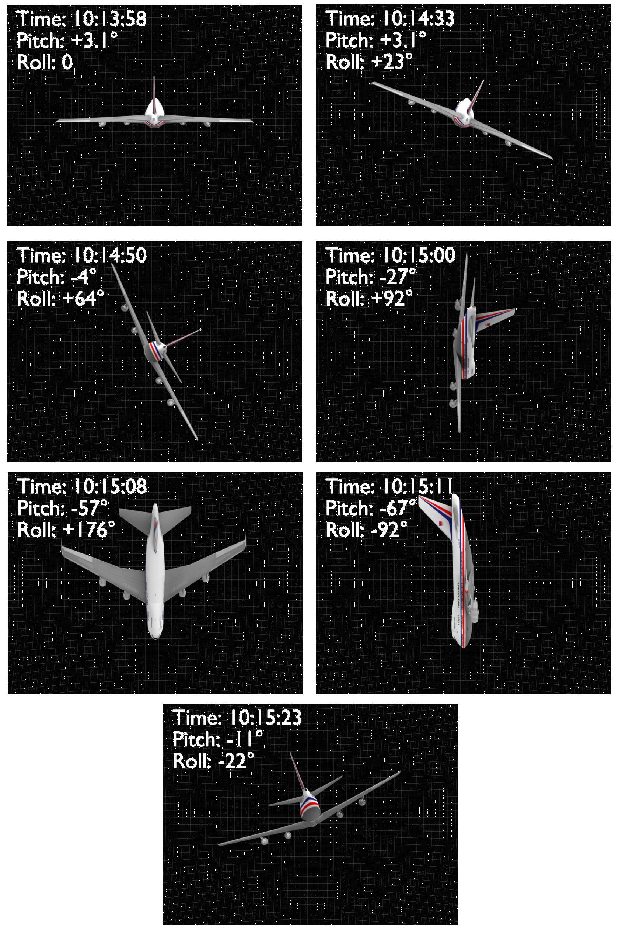
Alignment with UN Sustainable Development Goals (SDGs)
SDG 7: Affordable and Clean Energy:
Optimizes flight paths and ground operations to reduce fuel consumption
SDG 9: Industry, Innovation, and Infrastructure:
Implements cutting-edge technology to enhance airport and airline
SDG 7: Affordable and Clean Energy
SDG 11: Sustainable Cities
and Communities
Optimizes flight operations to
decrease noise pollution and
carbon emissions in urban
areas near airports.
SDG 17: Partnerships for the Goals
Enables data sharing and collaboration among airlines, governments, and international organizations.
.
This Photo by Unknown Author is licensed under CC BY-SA

Slide 5

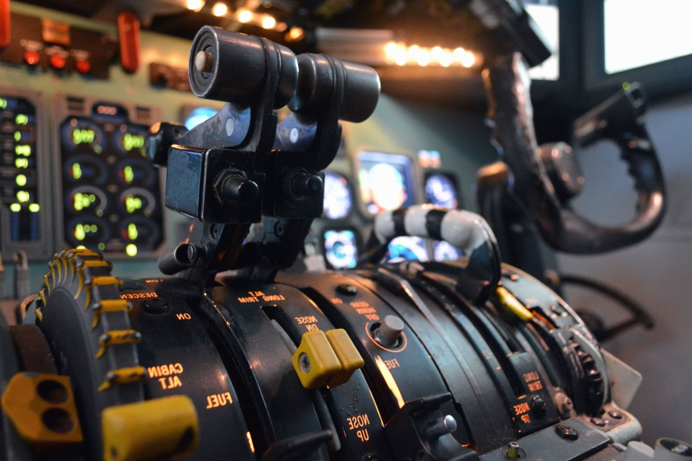




Methodology and Approach
Requirement Gathering and Analysis
Engage airlines, airports, passengers, and regulatory bodies to understand their specific requirements.
System Design and Architecture
Develop independent modules for flight scheduling, crew management, passenger services, and maintenance.
Development Approach
Build modules individually (e.g., Flight Operations, Maintenance Tracking).
Testing and Validation
Unit Testing: Validate individual components for correctness.
Integration Testing: Ensure modules communicate and function seamlessly together.
Performance Testing: Test the system for scalability, speed, and reliability under various workloads.

Slide 6


Key Project Deliverables
Capture the detailed requirements from stakeholders, outlining system functionality, user needs, and technical specifications.
Requirements Documentation
System Architecture and Design
Documentation
Define the system's overall architecture, including database schema, module structure, and integration points
.Flight Management Module.
.Passenger Services Module
.Maintenance Management Module
Reporting & Analytics Module:
Developed Modules

Slide 7
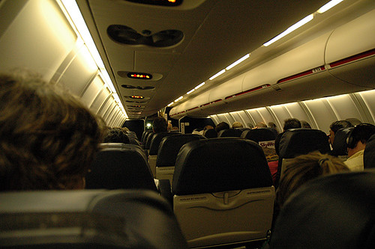

Next Steps and Conclusion
1
Finalizing Requirements
2
System Design and Prototyping
Conduct detailed discussions with key stakeholders (airlines, airports, government agencies, and passengers) to finalize the system requirements.
Develop the architectural blueprint for the AMS. Create a prototype of key modules (e.g., flight management, crew scheduling, and maintenance tracking) to demonstrate functionality.
3
Testing and Validation
This Photo by Unknown Author is licensed under CC BY-NC-ND
Ensure the system works seamlessly and meets all functional, security, and performance requirements..

